Slide 1
DATA 230 Data Visualization Week 1
Department of Applied Data Science San Jose State University Instructor: Robert Nicholson
sjsu.edu/people/robert.nicholson

Slide 2

My Background
Robert Nicholson
BS, Computer Science - 1975 CSU, Chico
MS, Computer Engineering – 1978 Stanford University
While in college, started a company building kit computers for local businesses
Engineering and Management: Hewlett-Packard, Oracle, Silicon Graphics, Sun Microsystems, Red Herring Communications, NASA, various startups
Currently independent software developer & consultant

Slide 3
Basic Info
Office hours
Fri 2:00-4:00 pm (or by appointment) via Zoom
Website
Syllabus, slides, assignments, etc, will be posted in Canvas
Faculty webpage: https://www.sjsu.edu/people/robert.nicholson/
Syllabus

Slide 4
Your Individual Overall Class Grade
50% assignments
20% midterm
30% final
During the semester, keep track of your progress in Canvas.
At the end of the semester, students with the median score will get the B+ grade.
Higher and lower grades will then be assigned based on how the scores cluster above and below the median. Approximately one third of the class will earn higher grades, and another one third will earn lower grades.
Therefore, your final class grade will be based primarily on your performance relative to the other students in the class.

Slide 5
Course Learning Outcomes
CLO 1: Understand the conceptual, design, and cognitive basis for effective data visualizations.
CLO 2: Identify and correct interface design and user interaction issues in data visualization.
CLO 3: Be able to effectively use a range of current data analysis and presentation tools in support of objectives (2) and (3).
This is an introductory/survey course. We’ll cover a lot of different topics – briefly. Depending on your background, some of the topics may be very easy for you, and some may be difficult.

Slide 6
Why Data Visualization?
Understanding
Understanding and exploring the data
Humans are incredibly good at recognizing visual patterns
Often a good first step before starting analysis

Slide 7
Why Data Visualization?
Presenting
Presenting and explaining conclusions is a big part of the data analyst’s job
Visualization is an effective tool for communicating

Slide 8
Why Data Visualization?
Persuading
Sometimes a data scientist’s role is persuading, or helping to persuade
Humans react differently to visual information; it can have much greater psychological impact

Slide 9
Why Data Visualization?
Interacting
Interactive visualization tools can support “discovery” and “what-if” explorations
Interaction can be a more effective way to absorb information
Interactive tools can support decision making

Slide 10
In This Class
Good and Bad visualization
Types of data visualization
Preparing data for visualization
Visual storytelling
Psychological principles
Accessibility
Dashboards & interaction
UI Design

Slide 11
In This Class (continued)
Visualization tools
Microsoft Excel
Python libraries
Tableau
Splunk
Power BI (PIBX)
Standards
File Formats

Slide 12
Good Data Visualization:
Communicates useful insights
Is easy to understand
Is easy to read
Is accessible
Is aesthetically pleasing
Is easy to interact with and use (good use interface)
Is unbiased (or appropriately biased)

Slide 13
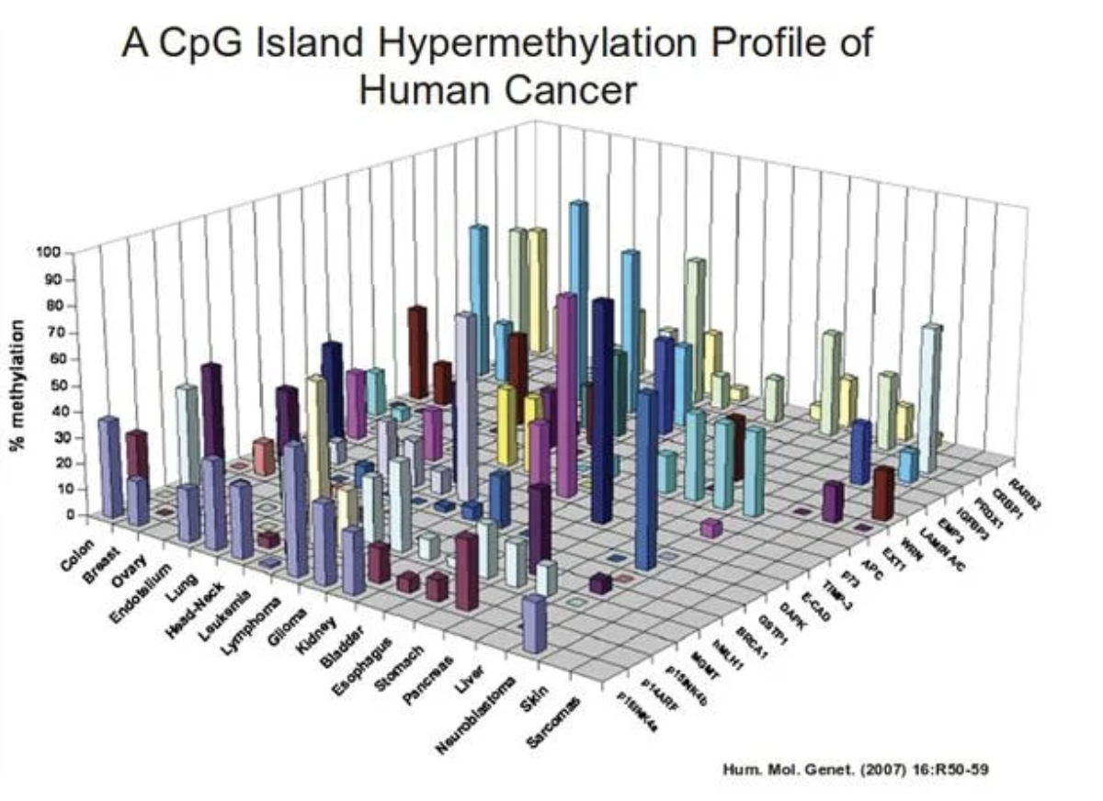
A Few Bad Visualizations

Slide 14
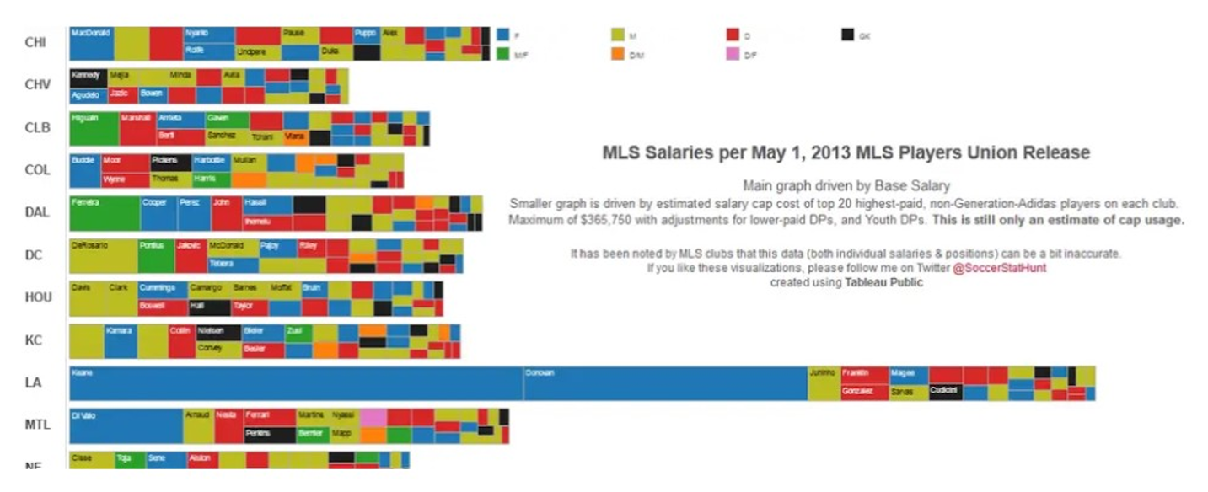
A Few Bad Visualizations

Slide 15
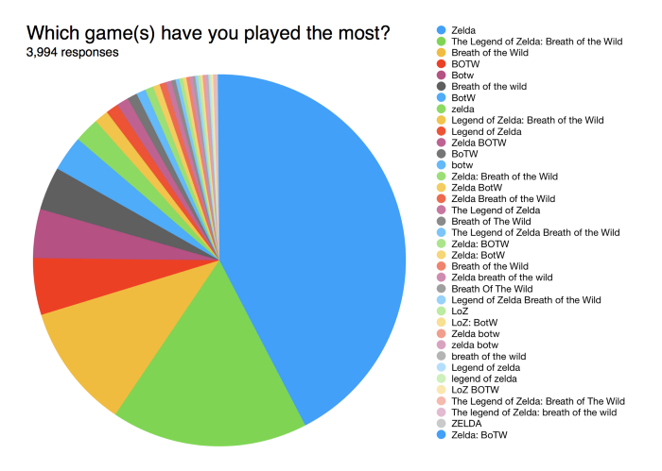
A Few Bad Visualizations

Slide 16
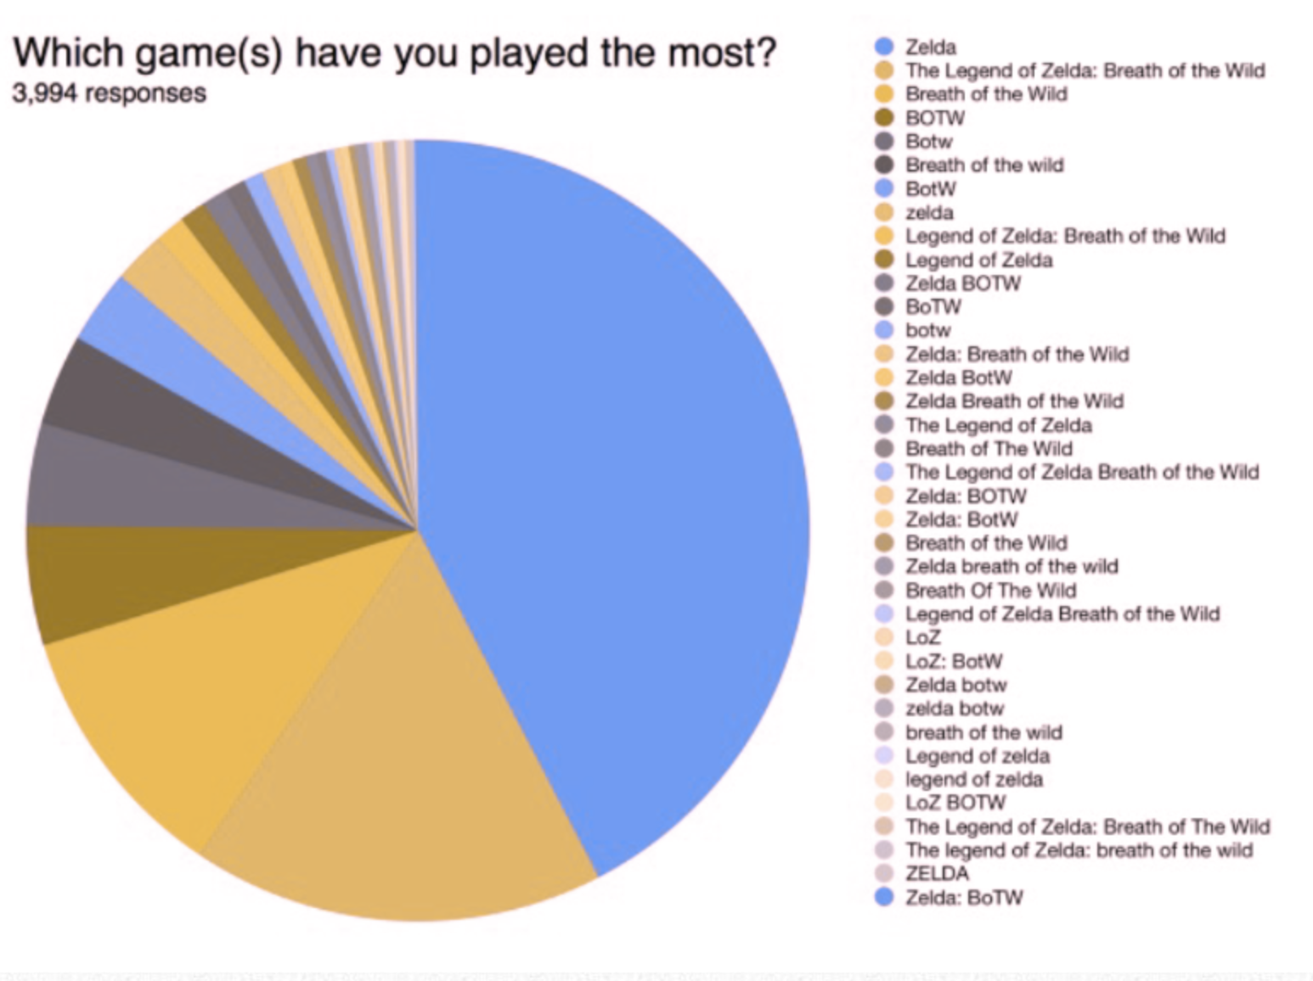
A Few Bad Visualizations
Green-Blind/Deuteranopia

Slide 17
Use of Color
Because a significant number of people have impair color vision, colors should not in general be used as the sole distinguishing characteristic. Use different shades, patterns, or shapes.
To help you make good color choices, there are online tools that will allow you to simulate color vision impairment:
https://www.color-blindness.com/coblis-color-blindness-simulator/
https://pilestone.com/pages/color-blindness-simulator-1

Slide 18
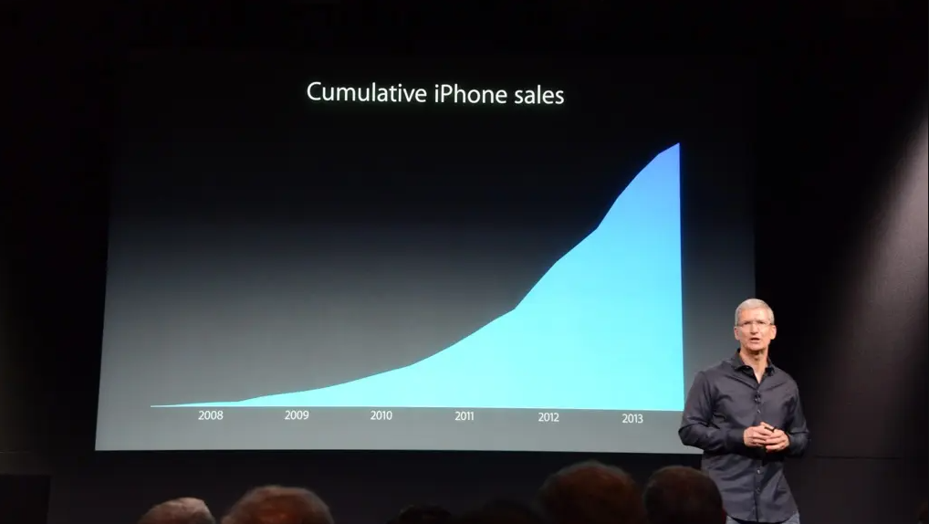
A Few Bad Visualizations

Slide 19
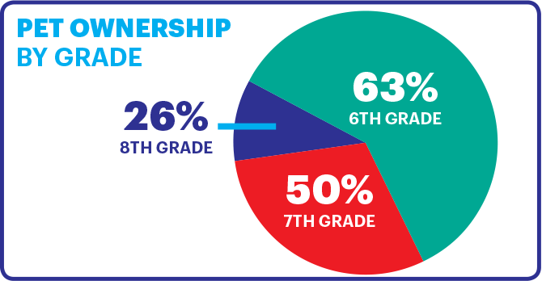
A Few Bad Visualizations

Slide 20
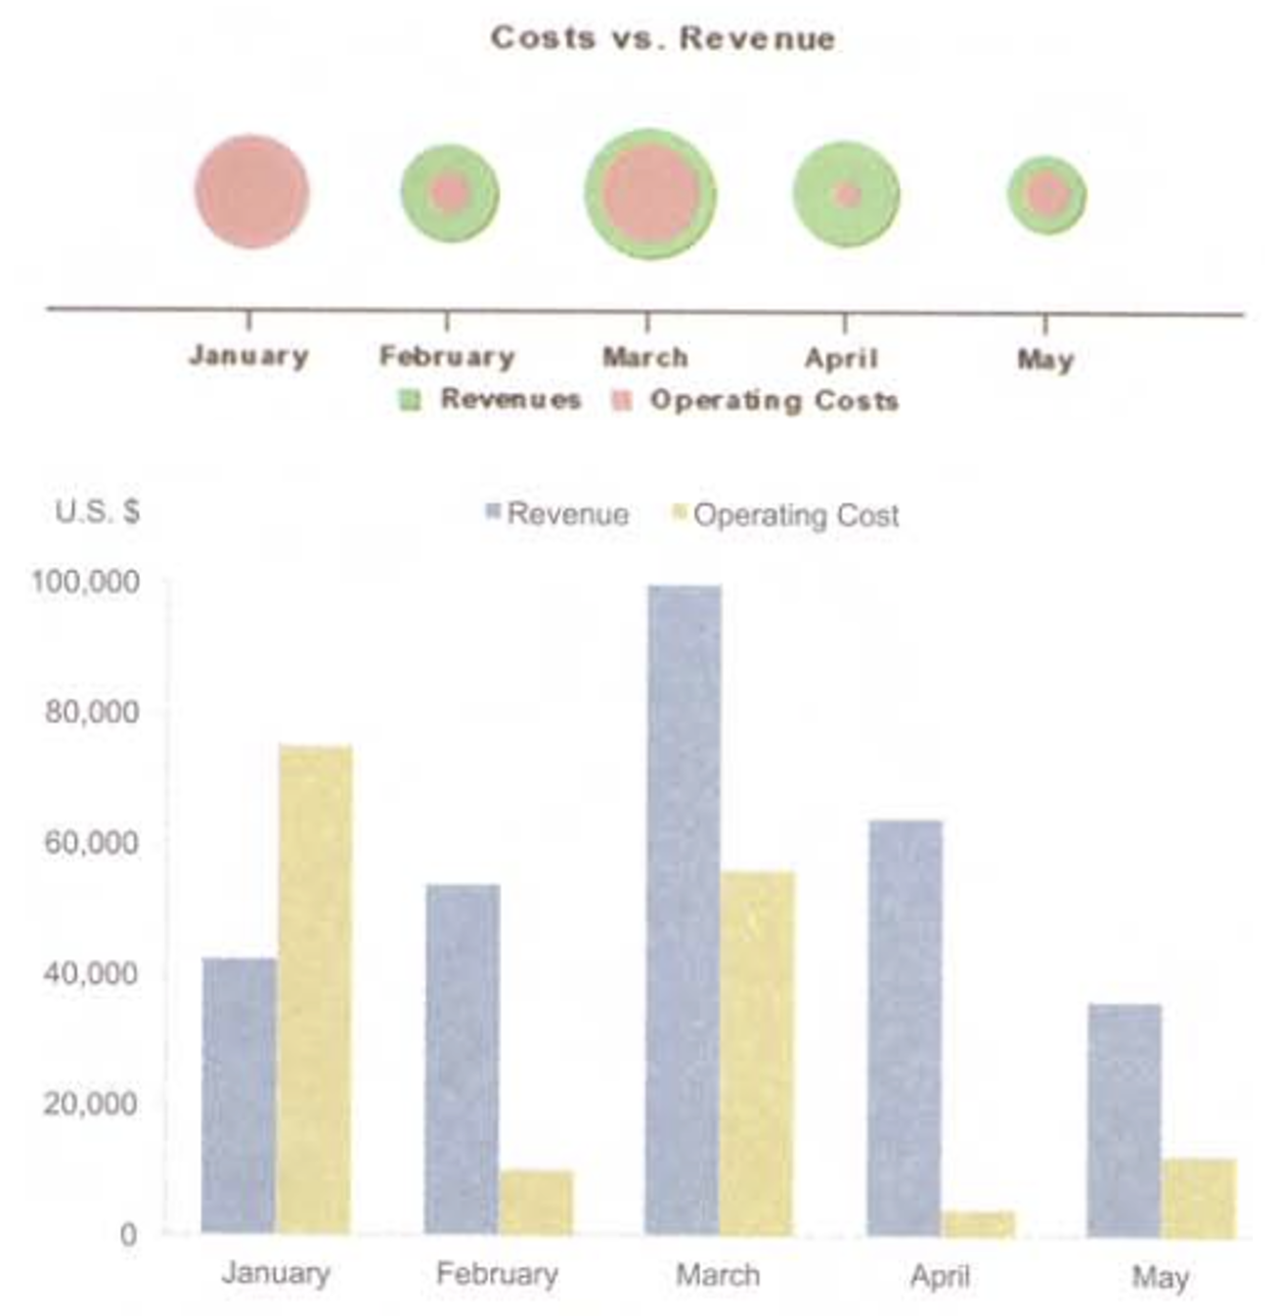
A Few Bad Visualizations

Slide 21
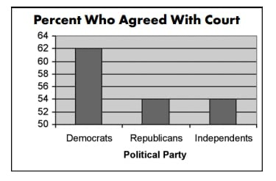
A Few Bad Visualizations

Slide 22
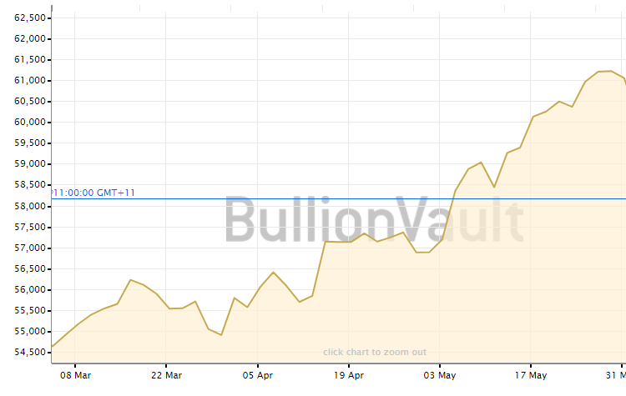
A Few Bad Visualizations

Slide 23
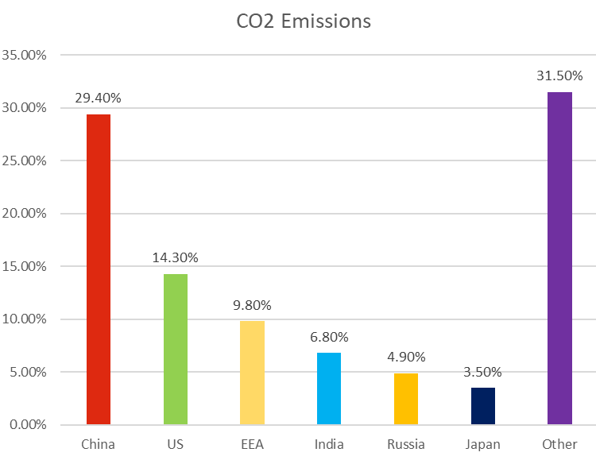
A Few Bad Visualizations

Slide 24
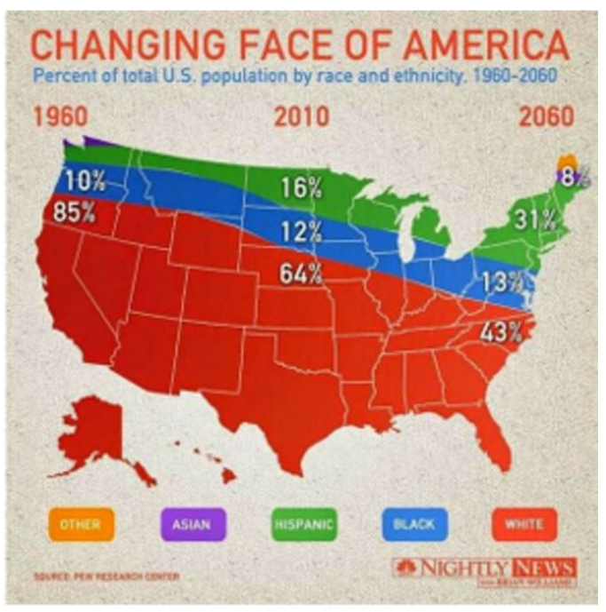
A Few Bad Visualizations

Slide 25
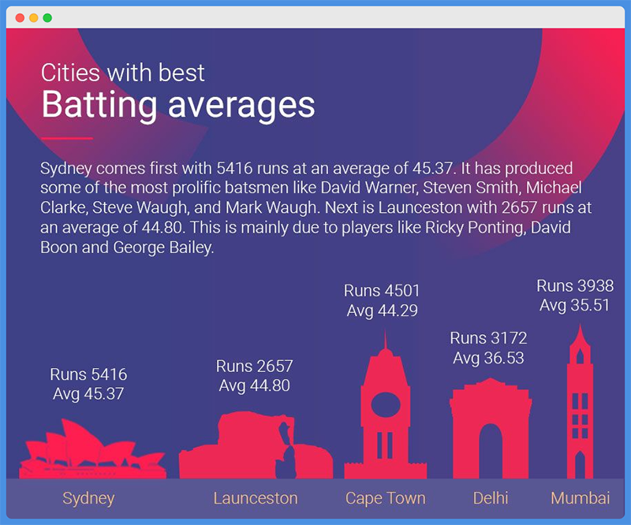
A Few Bad Visualizations

Slide 26
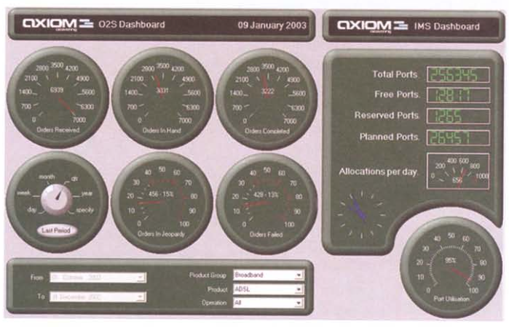
A Few Bad Visualizations
Information Dashboard Design, 2nd ed.
by Stephen Few
Analytics Press, 2013

Slide 27
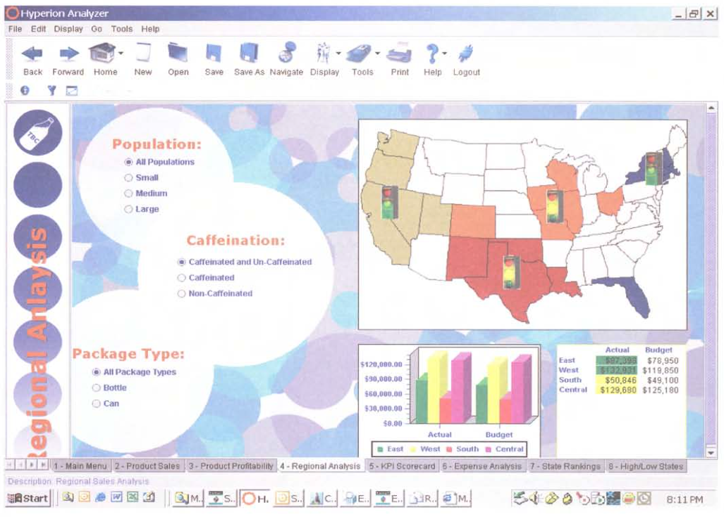
A Few Bad Visualizations
Information Dashboard Design, 2nd ed.
by Stephen Few
Analytics Press, 2013

Slide 28
Bad Design – Common Problems
Poor choice of chart type
Information overload
Misleading scale
Missing axis labels or scales
Incorrect data
Burying (not highlighting) key information

Slide 29
Bad Design (continued)
Inaccessible
Type too small
Poor color choices
Use of audio cues or messages
Meaningless (distracting) decoration & visual effects
Unclear (what does the graphic represent)
Poor aesthetics (ugly!)

Slide 30
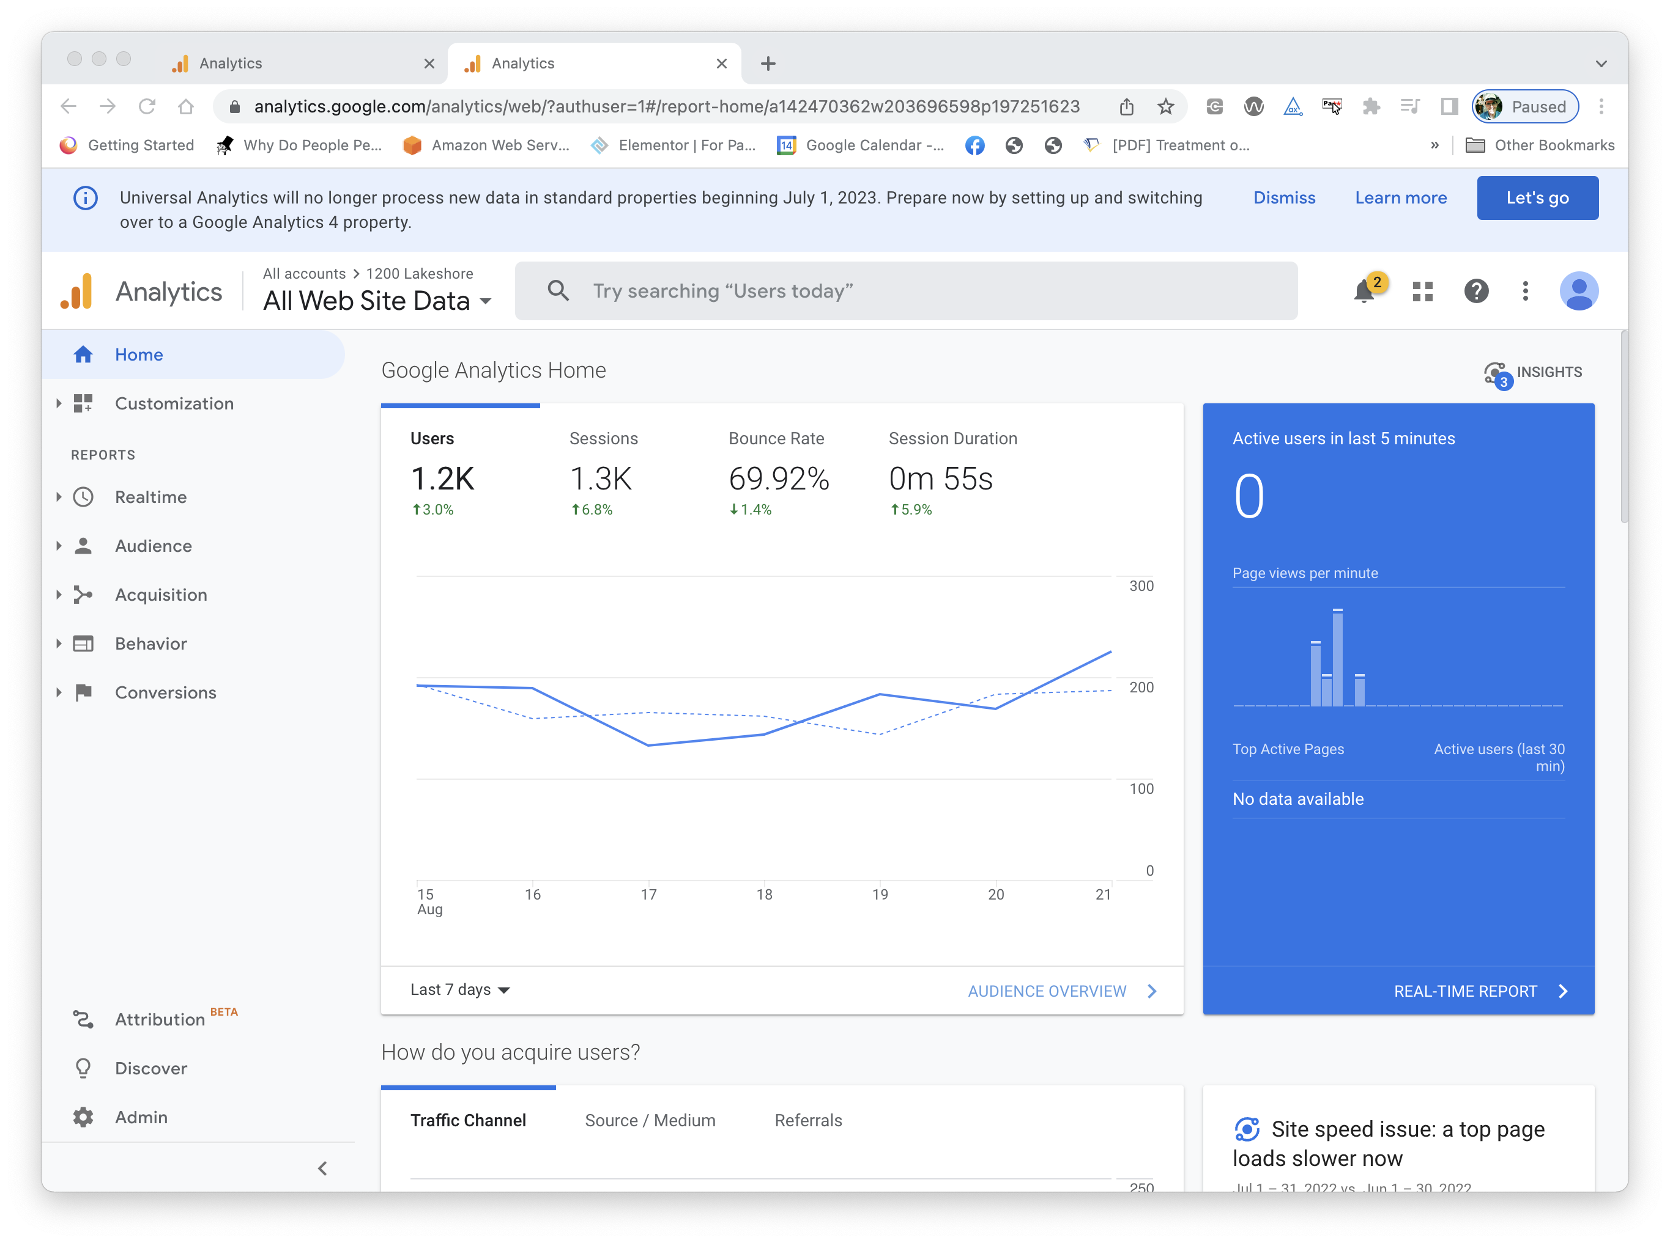
A Well- Designed Control Panel?

Slide 31
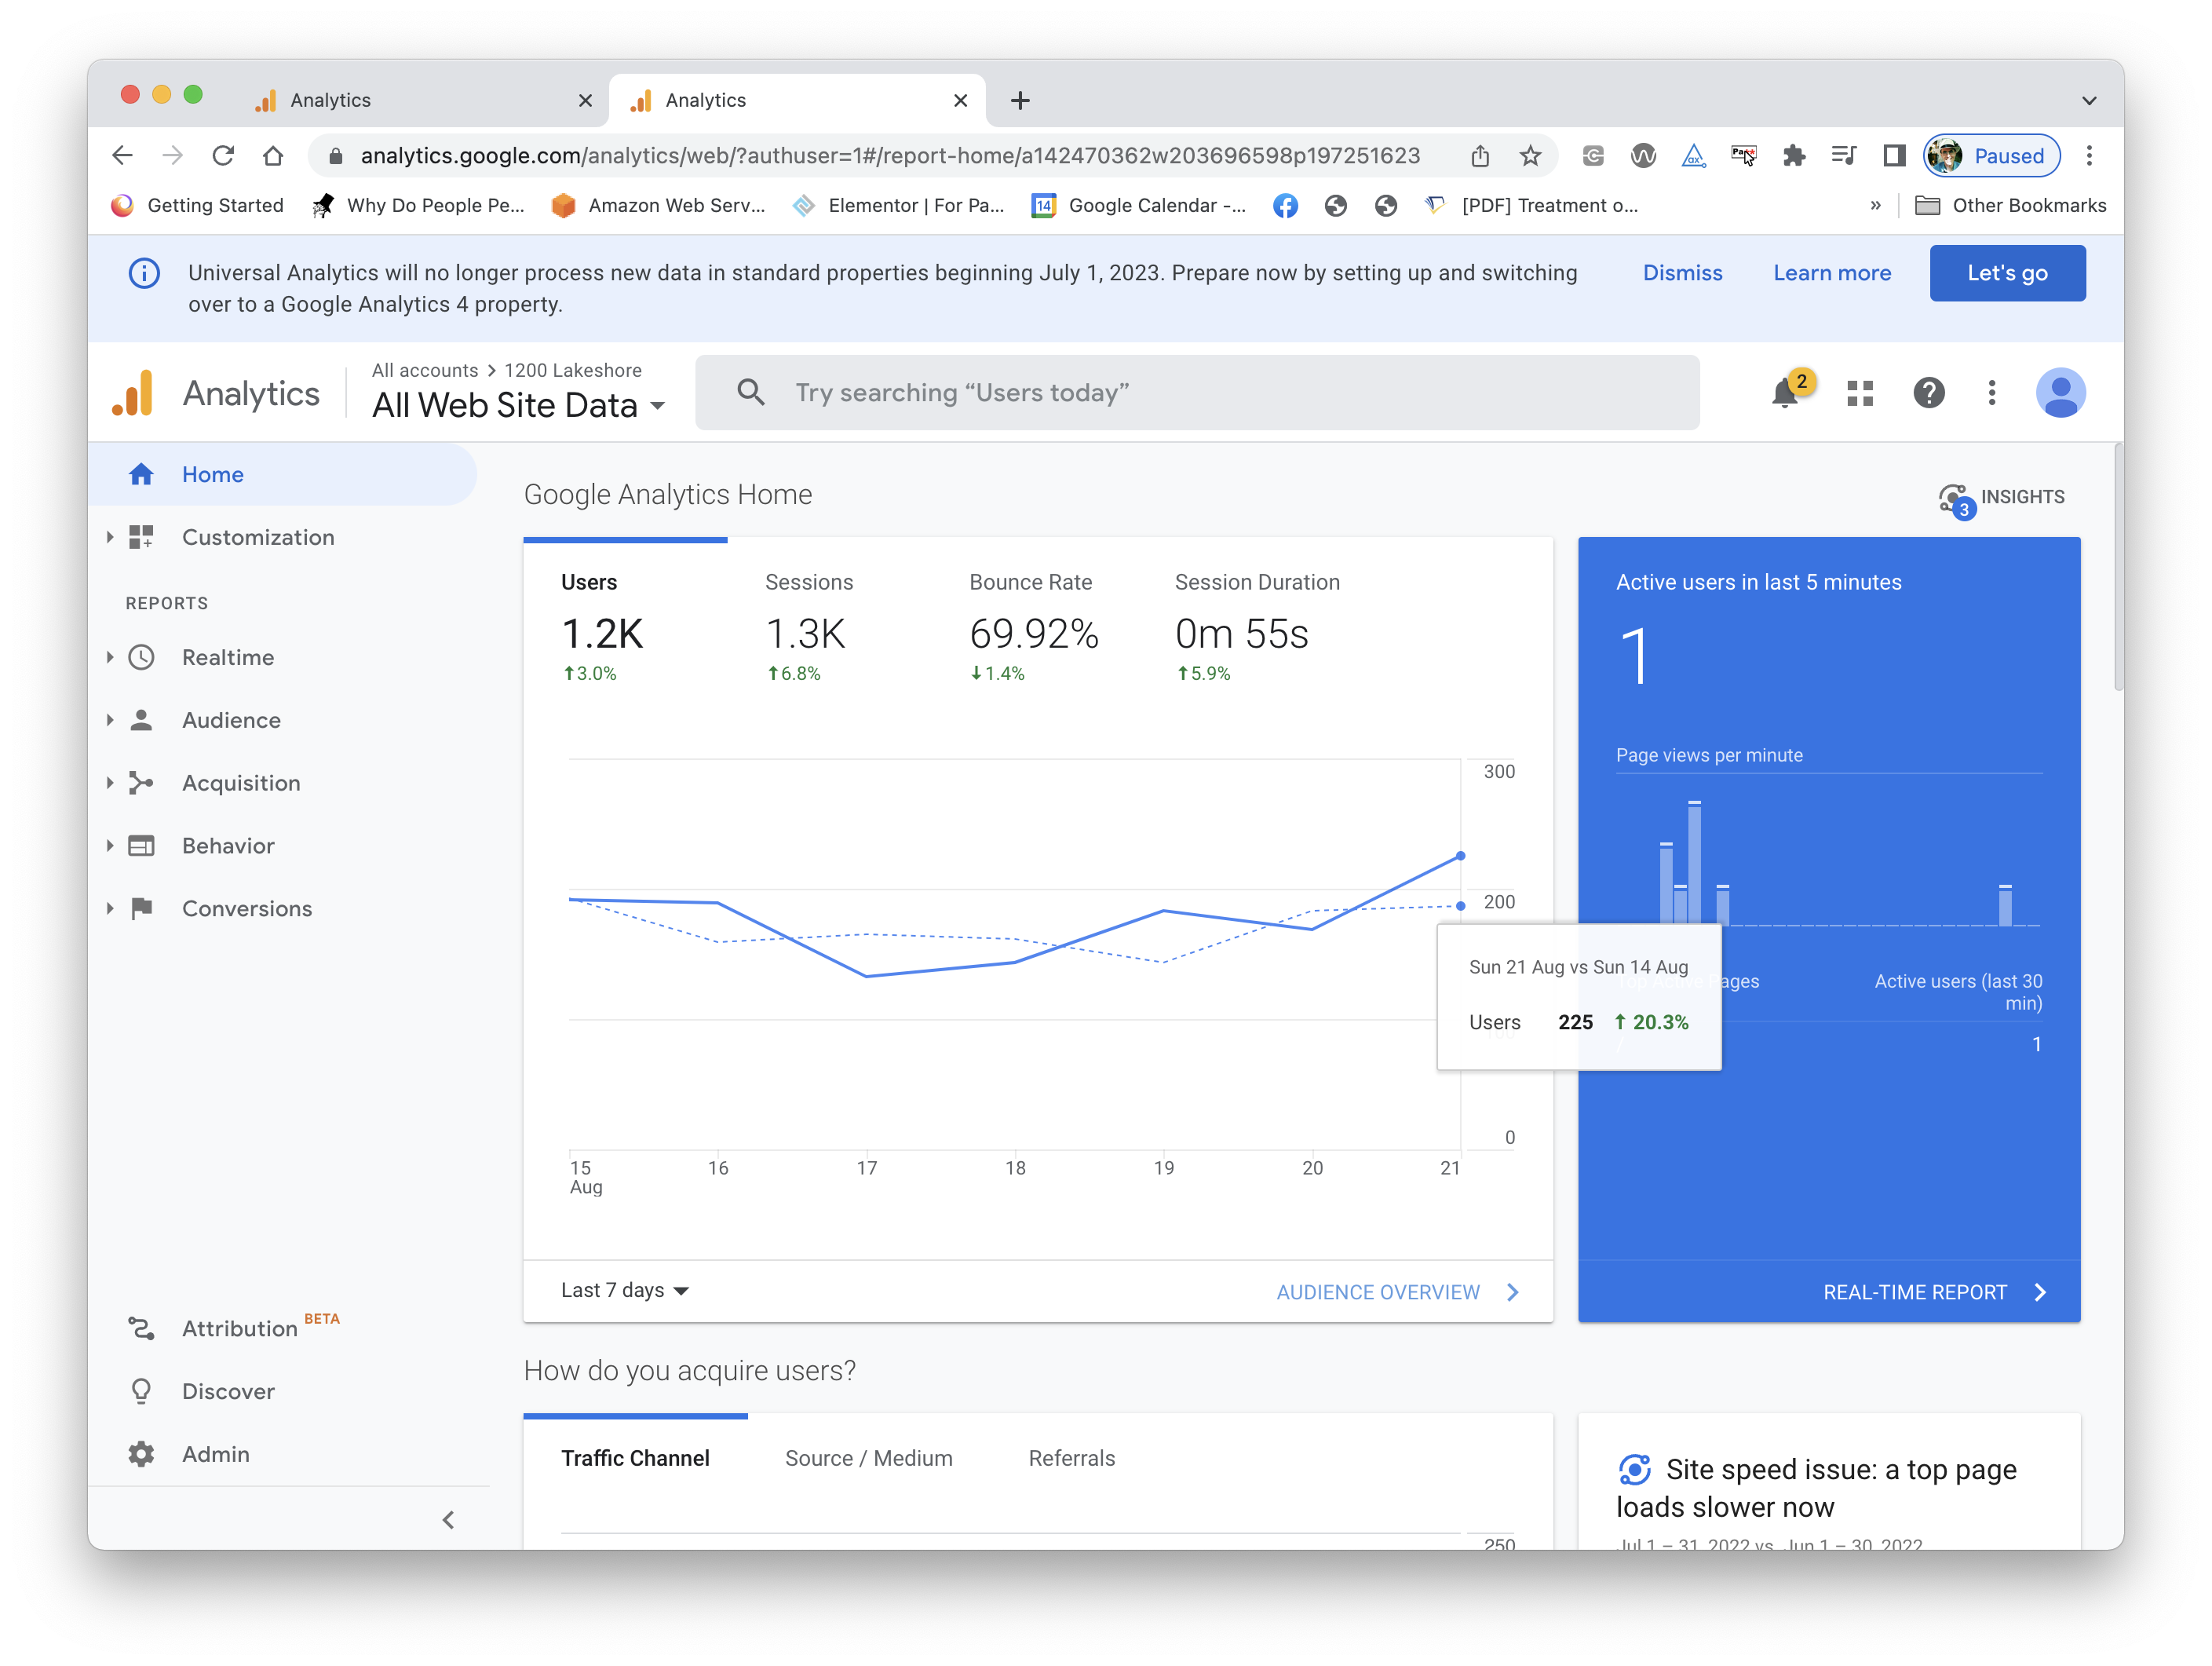
A Well- Designed Control Panel?

Slide 32
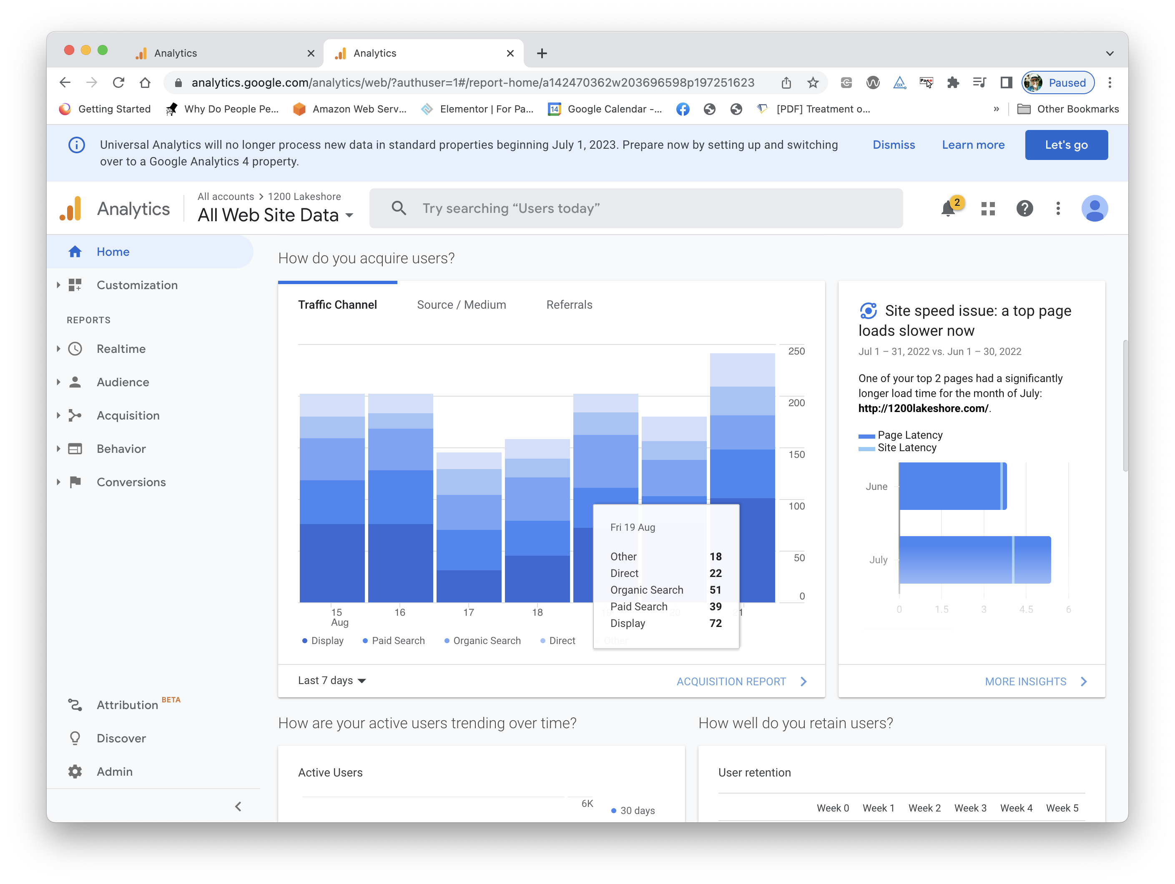
A Well- Designed Control Panel?

Slide 33
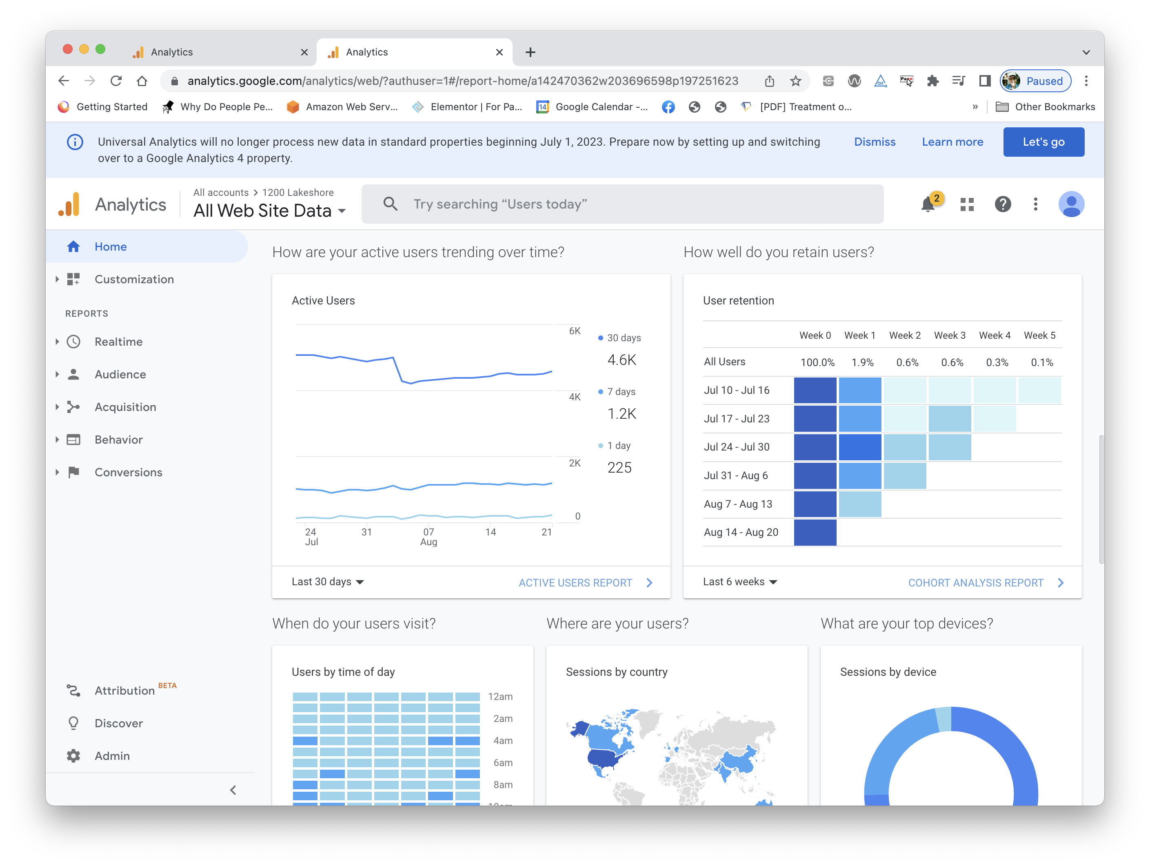
A Well- Designed Control Panel?

Slide 34
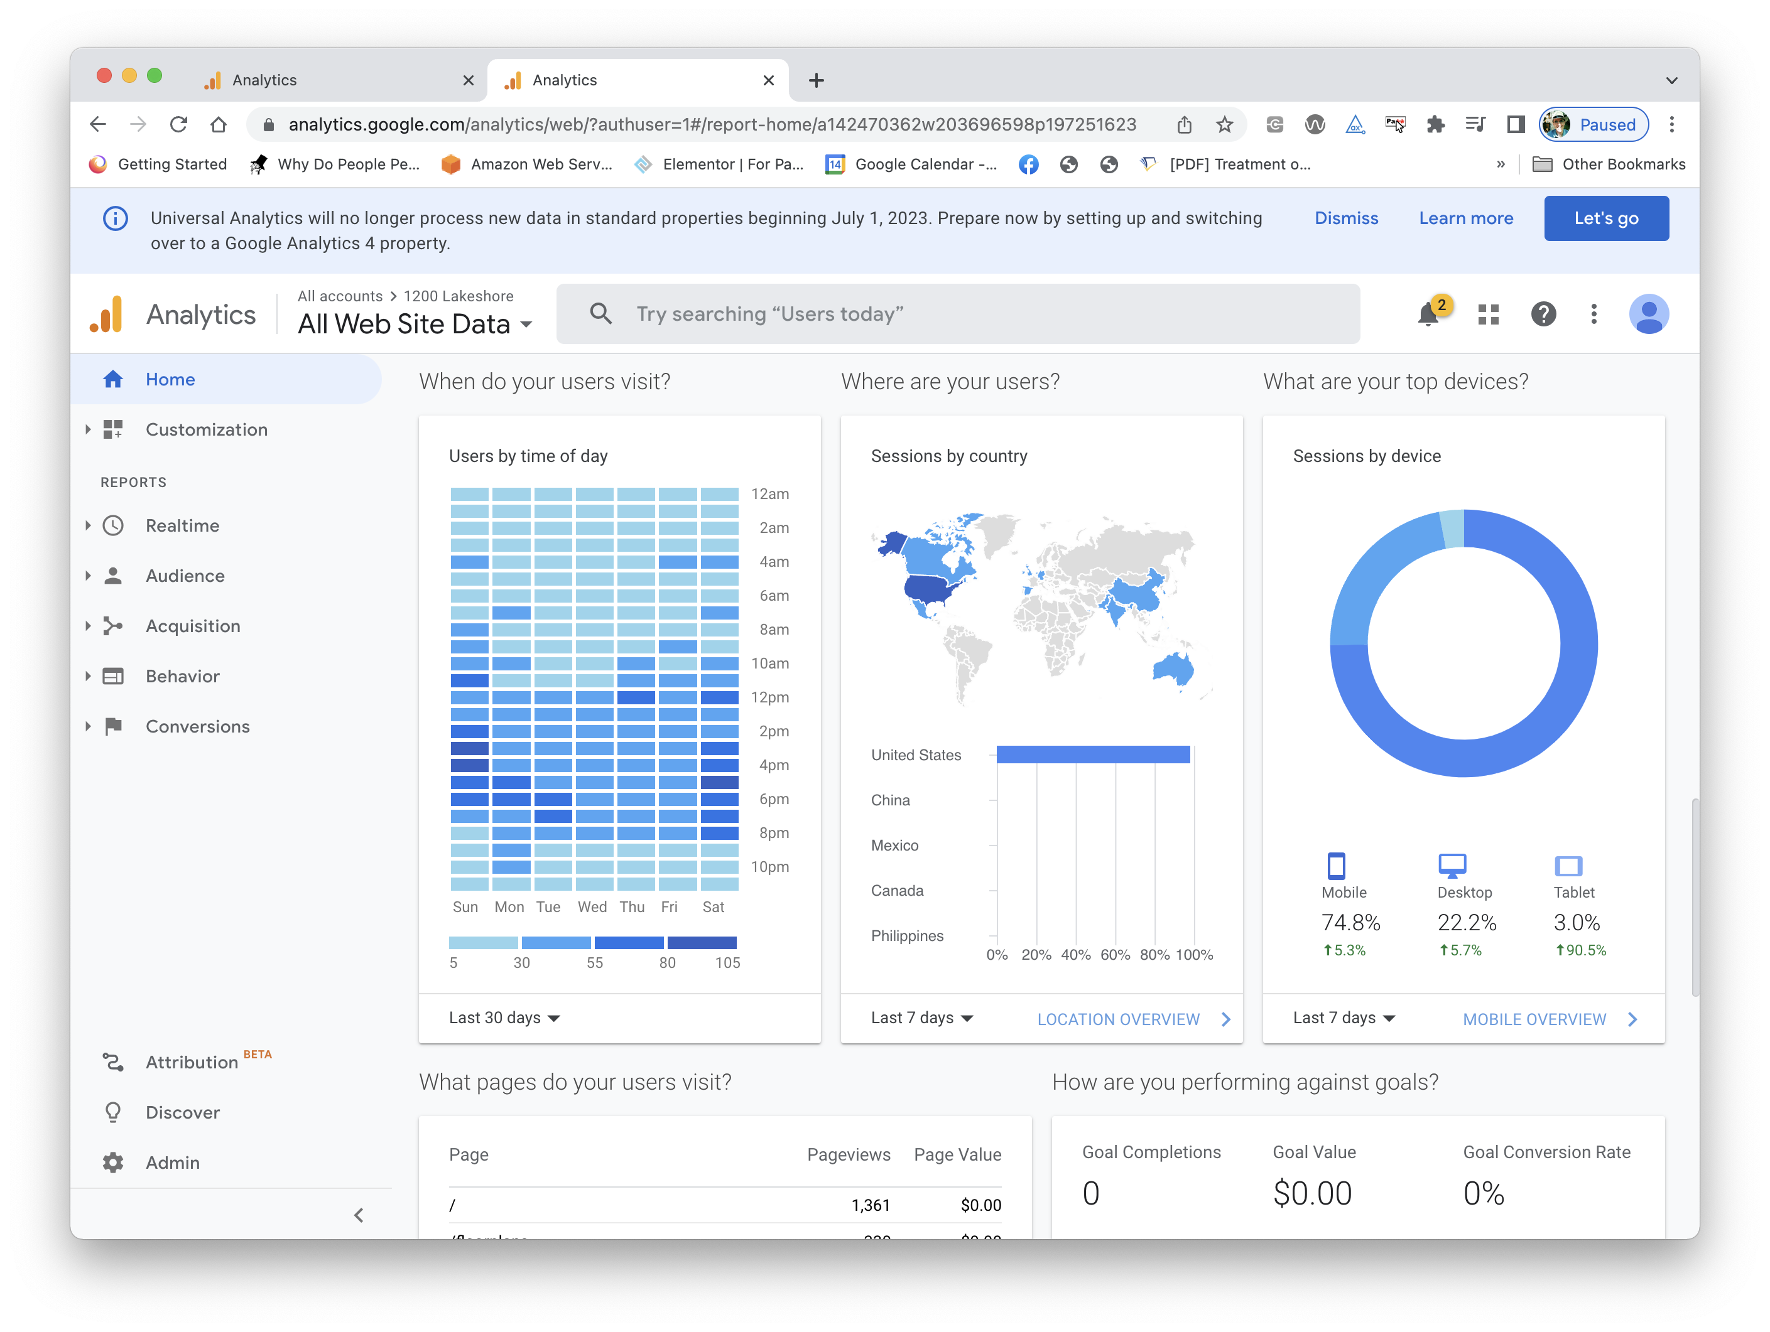
A Well- Designed Control Panel?

Slide 35
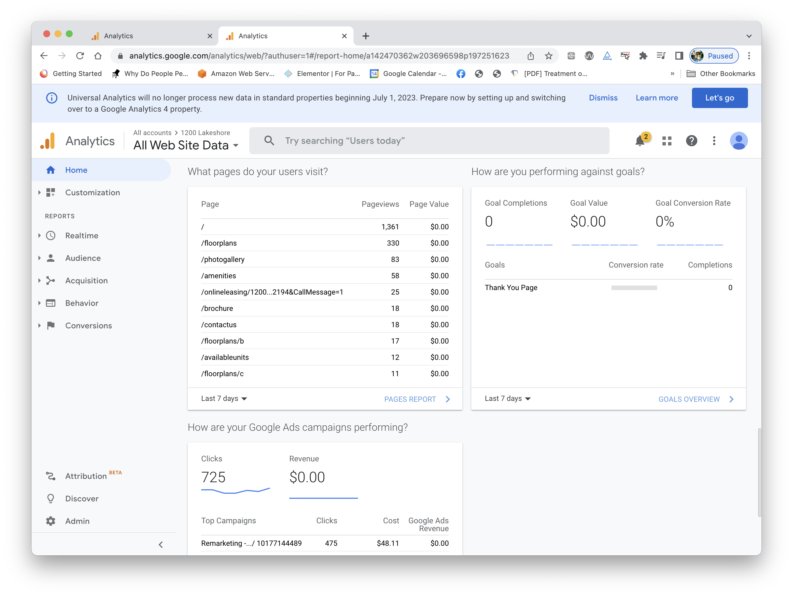
A Well- Designed Control Panel?

Slide 36
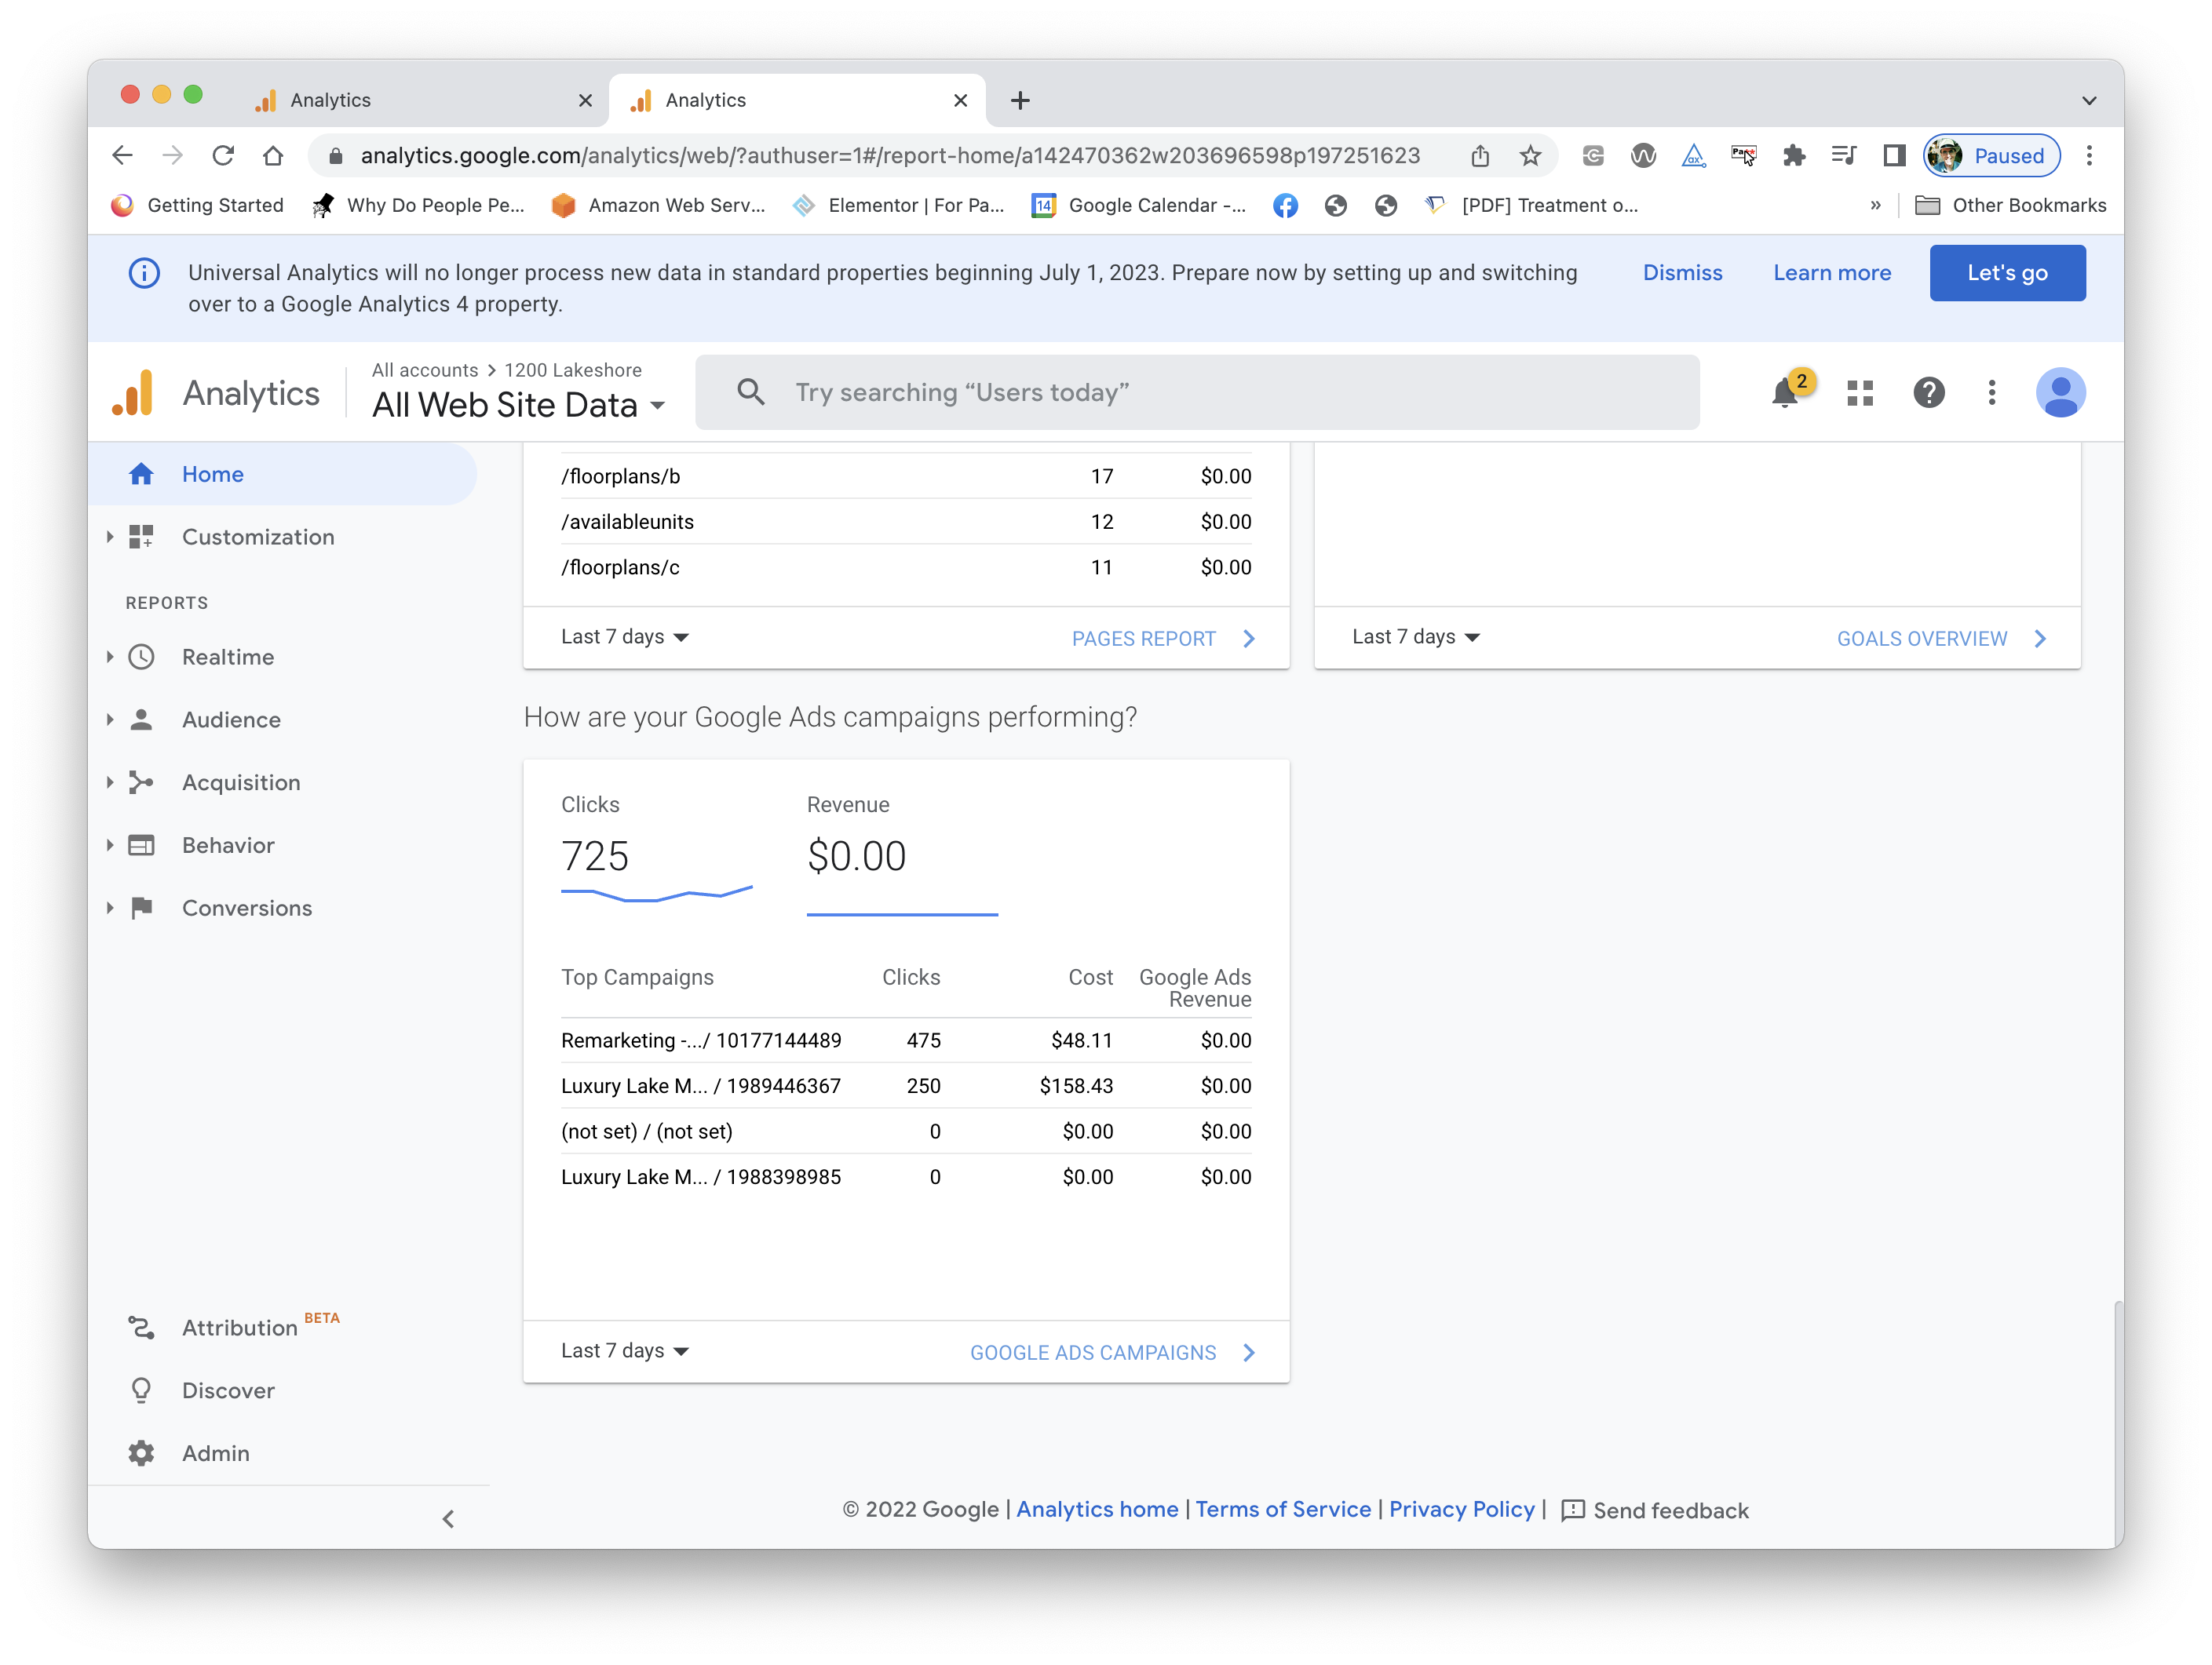
A Well- Designed Control Panel?

Slide 37
Assignment 1 – Due Next Week
You’ll submit a document in PDF form for this assignment.
On the web, find examples of five different data visualization problems. (Exactly five – no more, no less.)
Paste a screenshot of each into your document.
Based on the flaws discussed in class, identify the type of visualization problem that each illustrates.
Describe what you would do differently to fix the problem. You are welcome to create a graphic that shows how you would fix the problem, but that’s not necessary – a text description is fine.
Submit to Canvas as “Lastname-Assignment-1.pdf”
Please read pages 1-36 in the textbook

Slide 38
Assignment 1 – “permission to cheat”
You’ll find a lot of websites with examples of bad visualizations. You are welcome to use those for your assignment. (That’s where most of my examples came from – don’t use the same images!)
Just be sure to identify the problem based in the things I’ve just discussed, and explain how you would fix it.
Of course, it might be fun to actually look at some business and science sites to see if you can find some bad examples on your own.

